Slide 1
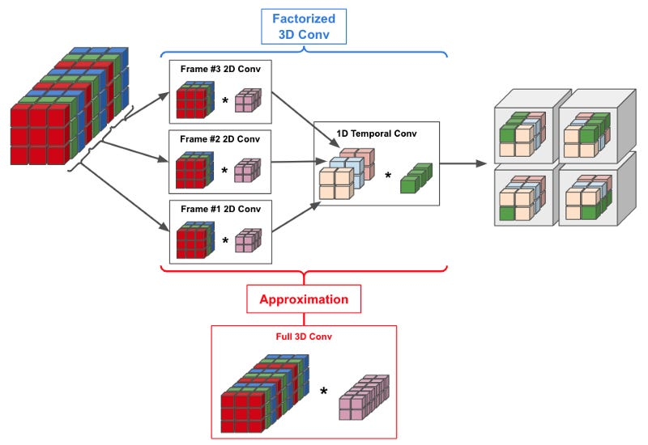
3D Convolutions: Beyond Flat Pixels
Standard CNNs process images as 2D grids, but medical data like MRI or CT scans are volumetric.
3D Convolutions (Conv3D): Instead of sliding a filter across height and width, the kernel slides across depth as well.
This allows the model to capture spatial relationships across multiple slices, which is essential for detecting structures that span across a 3D space.

Slide 2
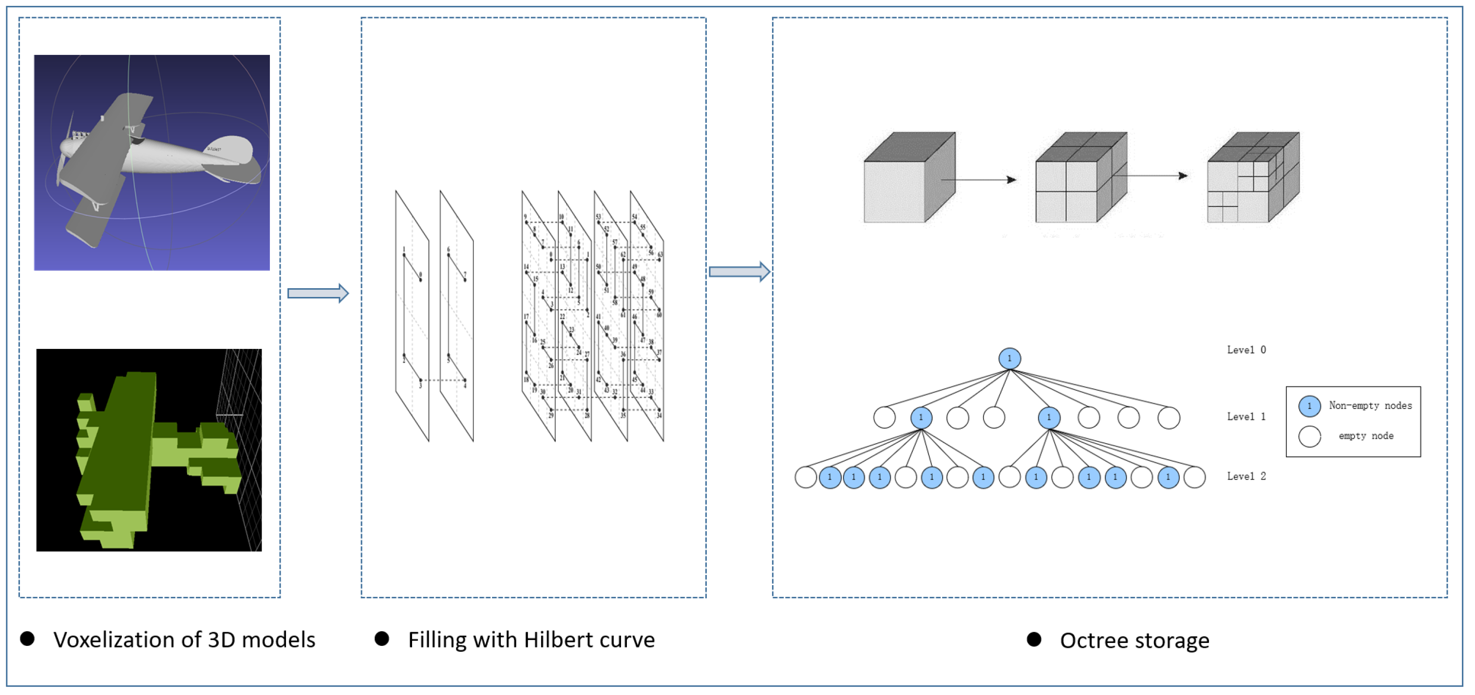
Voxel Analysis: Measuring the 3D World
A Voxel is the 3D equivalent of a pixel (Volume + Element).
Automated Volume Calculation: AI can be used to automatically calculate the volume of anomalies, such as tumors or lesions, by counting the predicted voxels.
This provides a much higher level of precision for doctors compared to manual 2D measurements.

Slide 3
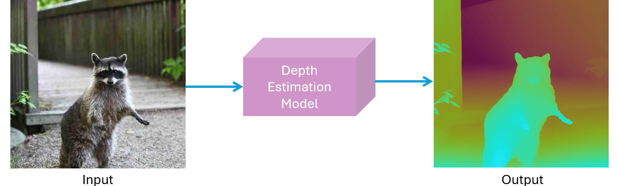
Depth Estimation: AI Understanding Distance
Depth estimation is the process of determining the distance of objects from the camera in a 2D image.
Monocular Depth: Predicting depth from a single image using patterns like perspective, shading, and object size.
This technology is vital for autonomous driving (avoiding obstacles) and augmented reality (AR).

